Slide 1
Chapter 2 – A visual example of elastic RTM

Slide 2
Chapter 2 – RTM – A Visual example
Suppose this is the model of that I am trying to recover, m:

Slide 3
Chapter 2 – RTM – A Visual example
Suppose this is the model of that I am trying to recover, m:
Water layer (known)
m₀
Unknown layer

Slide 4
Chapter 2 – RTM – A Visual example
I will acquire data by simulating a source at top and receivers on both sides of it:

Slide 5
Chapter 2 – RTM – A Visual example
This is the image I hope to recover, given the limited bandwidth of the data:

Slide 6
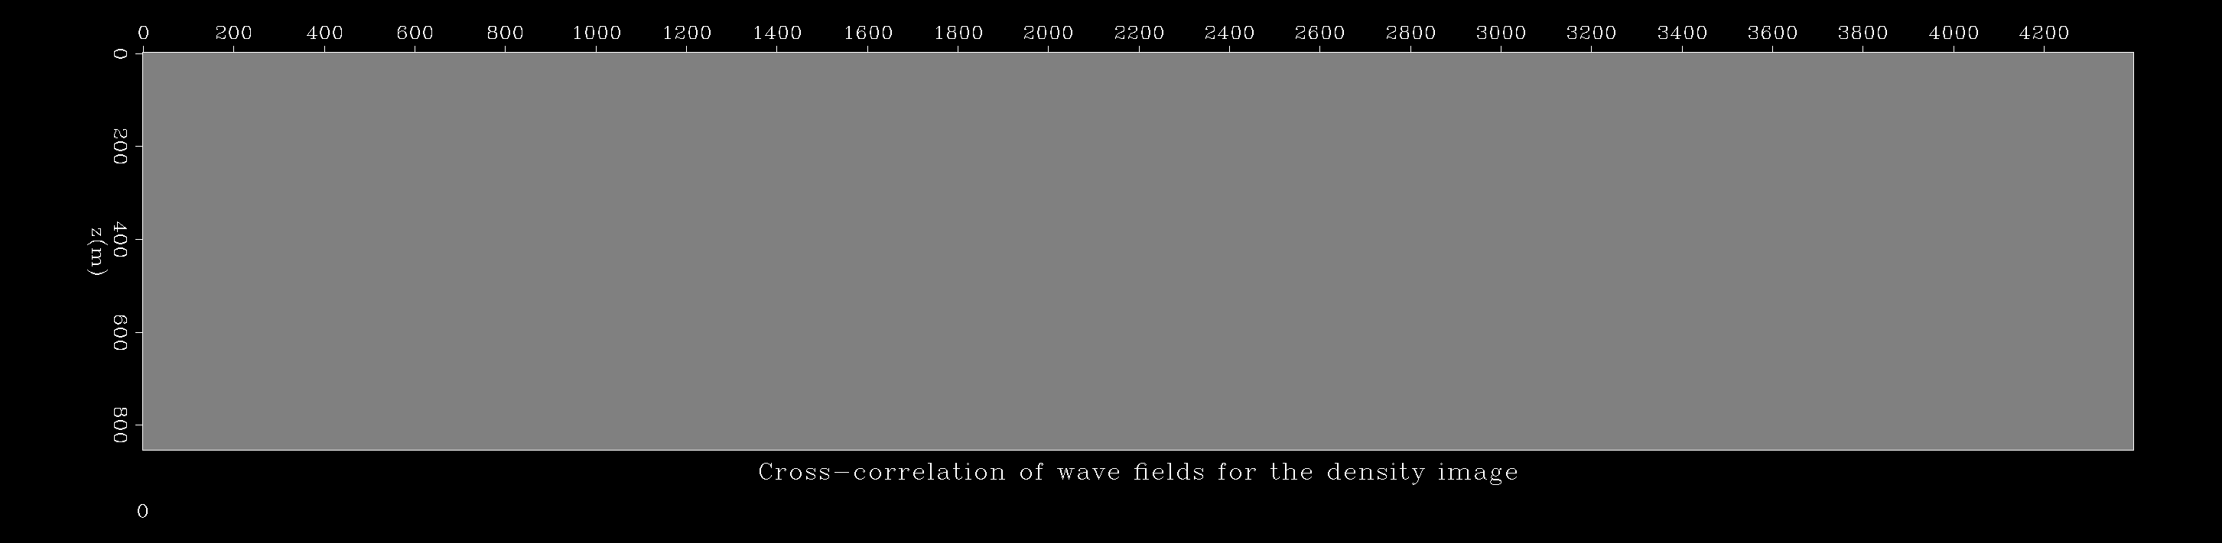
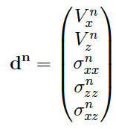
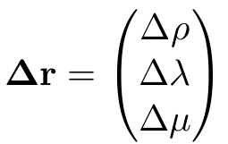
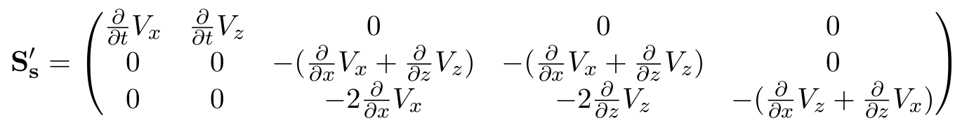
Chapter 2 – RTM – A Visual example

Slide 7
Chapter 2 – RTM – A Visual example

Slide 8

Chapter 2 – RTM – A Visual example

Slide 9
Chapter 2 – RTM – A Visual example

Slide 10
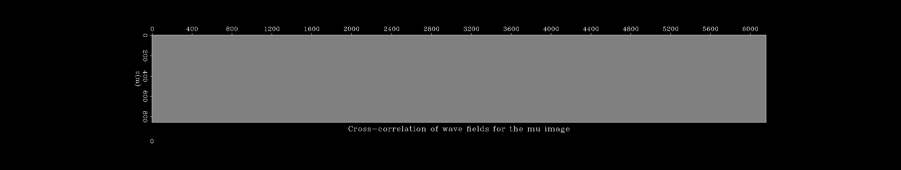
Chapter 2 – RTM – A Visual example

